Slide 1
CSE408
DESIGN AND ANALYSIS OF ALGORITHMS

Slide 2
Unit III
Dynamic Programming :
Introduction to Dynamic Programming,
Computing a Binomial Coefficient,
Memory Functions,
Knapsack Problem,
Matrix-Chain Multiplication,
Longest Common Subsequence,
Optimal Binary Search Trees

Slide 3
Dynamic Programming
It is mainly an optimization over plain recursion. Wherever we see a recursive solution that has repeated calls for the same inputs, we can optimize it using Dynamic Programming.
The idea is to simply store the results of subproblems so that we do not have to re-compute them when needed later. This simple optimization typically reduces time complexities from exponential to polynomial.
Some popular problems solved using Dynamic Programming are Fibonacci Numbers, Diff Utility (Longest Common Subsequence), Bellman–Ford Shortest Path, Floyd Warshall, Edit Distance and Matrix Chain Multiplication.

Slide 4
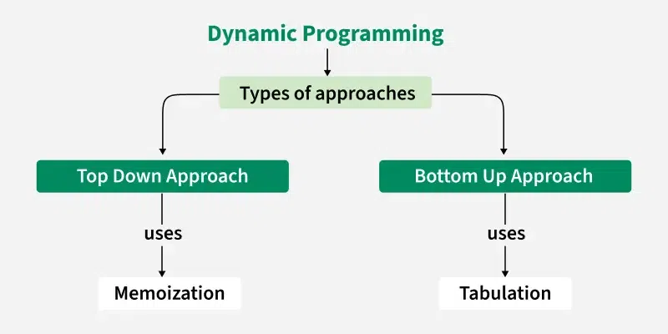
Core Properties
Overlapping Sub problems
Optimal Substructure
1) Recursion based(first call – first fill)
2) Iteration based(Sequential fill)

Slide 5
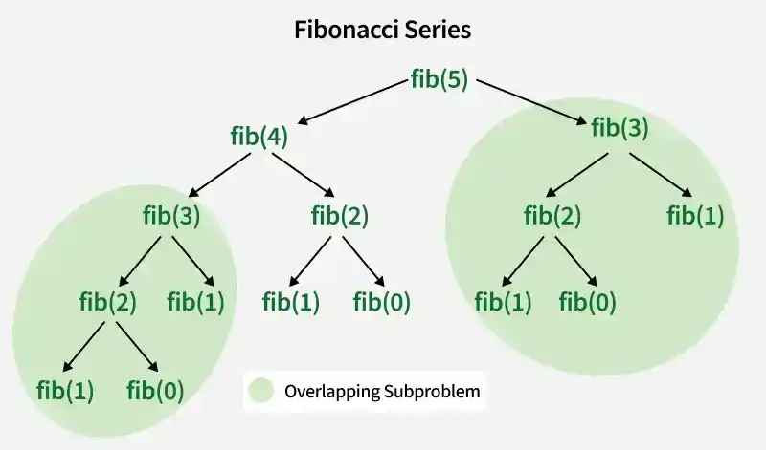
Fibonacci Series
int fib(int n) {
if (n <= 1) {
return n;
}
return fib(n - 1) + fib(n - 2);
}

Slide 6
Memoization method
Top-down approach
Stores the results of function calls in a table.
Recursive implementation
Entries are filled when needed.

Slide 7
Tabulation method
Bottom-up approach
Stores the results of subproblems in a table
Iterative implementation
Entries are filled in a bottom-up manner from the smallest size to the final size

Slide 8
Binomial Coefficient
^{n}C_{k –} Select k out of n
C(n, k) = {n!}/{k!*(n-k)!}
C(n, k) = C(n-1, k-1) + C(n-1, k)
Base case:- C(n, 0) = 1,
C(n, n) = 1(n==k)
But k< n

Slide 9
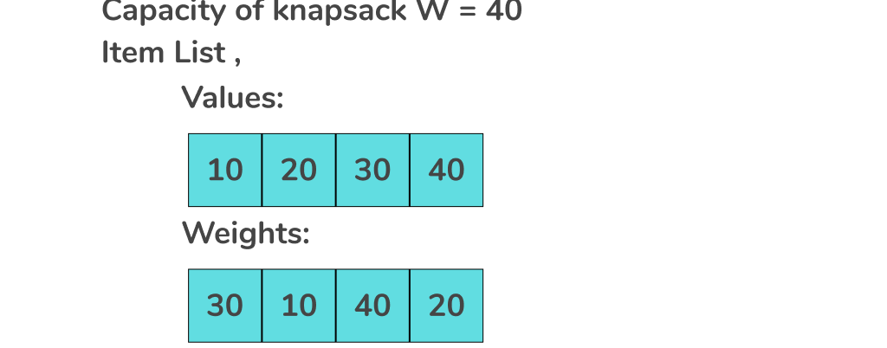
0/1 Knap Sack Problem

Slide 10
Base Case n=0, W=0
1) profit1 = Knapsack(n-1, W)
2) weight[n] <= W)। ===
profit2 = value[n] + Knapsack(n-1, W - weight[n])
max(profit1, profit2)

Slide 11
Algorithm
int knapsackTab(int W, int wt[], int val[], int n) {
int dp[n+1][W+1];
for (int i = 0; i <= n; i++) {
for (int w = 0; w <= W; w++) {
// Base Case:
if (i == 0 || w == 0) {
dp[i][w] = 0;
}
// (Take or Leave)
else if (wt[i-1] <= w) {
dp[i][w] = max(val[i-1] + dp[i-1][w - wt[i-1]], dp[i-1][w]);
}
// (Leave)
else {
dp[i][w] = dp[i-1][w];
}
}
}
return dp[n][W]; // Answer
}

Slide 12
int val[] = {60, 100, 120};
int wt[] = {10, 20, 30};
int W = 50;

Slide 13
Matrix Chain Multiplication
A1(2x5), A2(5x10), A3(10x3)
Arr={2,5,10,3}// P0 =2, P1 = 5, P2 =10, P4=3
i) BxC = 5x10x3 =150
ABC = 2x5x3 = 30
M[1,3] =M[1,1] + M[2,3] + P0xP1xP3 = 0 + 150 + 30 = 180
ii)AxB = 2x5x10 = 100
ABC = 2x10x3 = 60
M[1,3] =M[1,2] + M[3,3] + P0xP2xP3 = 100 + 0 + 60 = 160

Slide 14
Base Case - M[i][i] = 0(i = j),
M[i][j] = min_{i <=k < j} (M[i][k] + M[k+1][j] + P[i-1]-P[k] - P[j])

